Slide 1
Smart Medicine Dispenser
By Rushitha Satla

Slide 2
Introduction
Purpose of Smart Medicine Dispenser:
Utilizes IoT technology to automate medication management.
Enhances medication adherence by providing automated dispensing based on schedules or user requests..
Improvement in patient care:
Enables personalized medication schedules tailored to individual needs.
Provides real-time monitoring and remote management capabilities for caregivers or healthcare providers.
Reduces medication errors and enhances patient safety through automated dispensing.

Slide 3
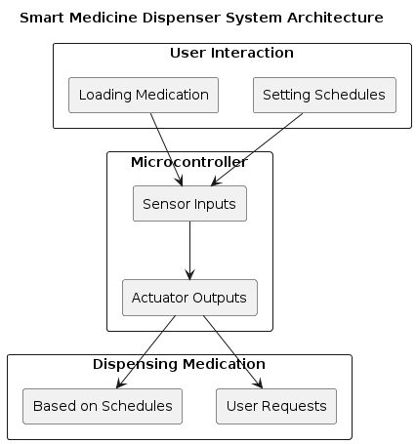
Flow Chart/Block Diagram

Slide 4
Components Used
IoT Microcontroller (ESP32 Chip):
ESP32 is a series of low-cost, low-power system on a chip microcontrollers with integrated Wi-Fi and dual-mode Bluetooth. Sensors:
Weight Sensors: Measure medication quantity to ensure accurate dispensing.
Proximity Sensors: Detect user interaction for loading medication or requesting dispensing.
Actuators:
Servo Motors: Responsible for dispensing the correct amount of medication.
Connectivity Modules:
Wi-Fi or Bluetooth: Enable communication between the dispenser and external devices (ESP32 Chip).

Slide 5
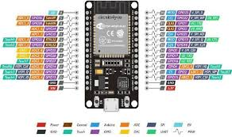
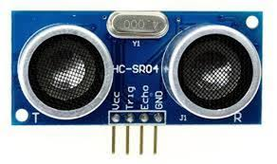
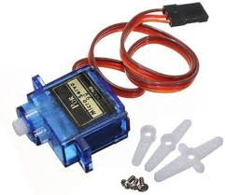
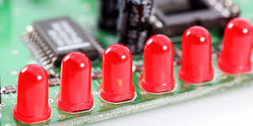
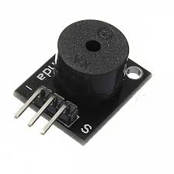

Slide 6
Working
Operation of the Smart Medicine Dispenser:
User Interaction Flow:
Loading Medication: User places medication into the dispenser.
Setting Schedules: User configures medication schedules via a mobile app or web interface.
Automated Dispensing:
Dispensing Trigger: System dispenses medication based on scheduled times or user requests.
Sensor Feedback: Sensors ensure accurate dispensing and provide feedback to the microcontroller for validation.

Slide 7
Advantages and Applications
Benefits of Smart Medicine Dispenser:
Improved Medication Adherence: Enhance patient compliance with prescribed medication regimens.
Remote Monitoring and Management:
Caregivers or healthcare providers can monitor medication adherence and intervene remotely if needed.
Integration with Healthcare Systems:
Potential integration with electronic health records (EHRs) for data analysis and personalized patient care.

Slide 8
Thank You

